Slide 1
SECE Geoloc
Under Prof. Henning Schulzrinne
Advised by: Jan Janak
Riddhi Mehta (rnm2119)
MS Computer Science
Columbia University

Slide 2
Geoloc
Geoloc is a functionality within SECE which has been implemented in order to provide the users the ability to locate the user’s smart objects within the sense everything control everything system by means of geographical co-ordinates.
Outdoor Maps
Indoor Maps

Slide 3
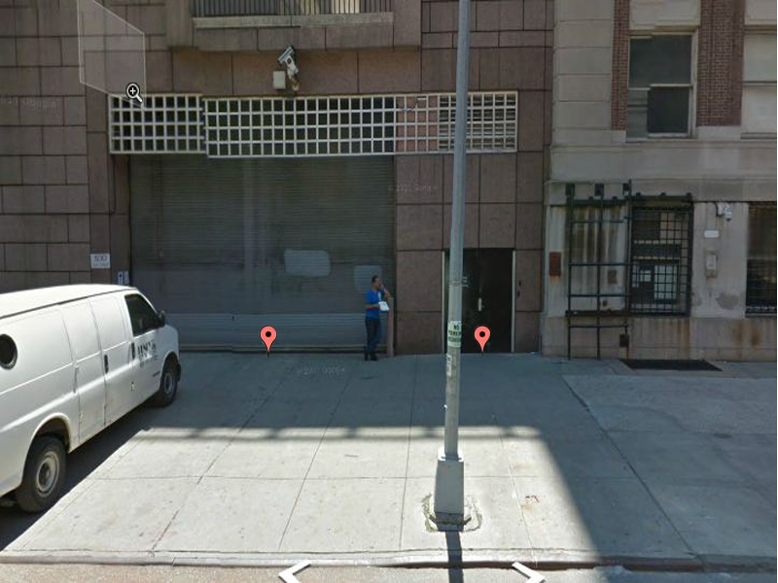
Challenges
Distinguishing 2 locations at the street level using overhead maps
Getting the exact location of the smartObject since the marker dropped in street view indicates the lat, lng of the center of the street
Calculating the latitude, longitude values for the floor-plan uploaded by the user from pixel values

Slide 4
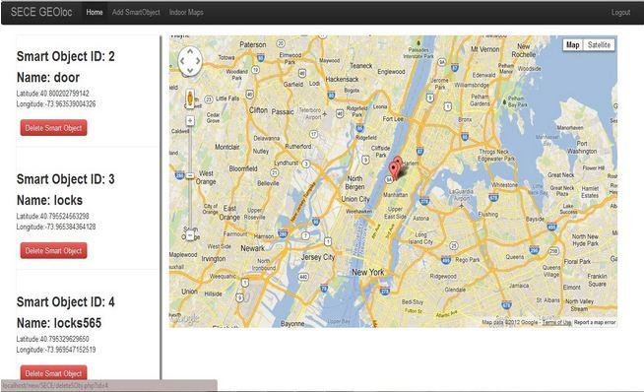
Outdoor Maps
Google maps API
Add, view & delete smartObjects

Slide 5
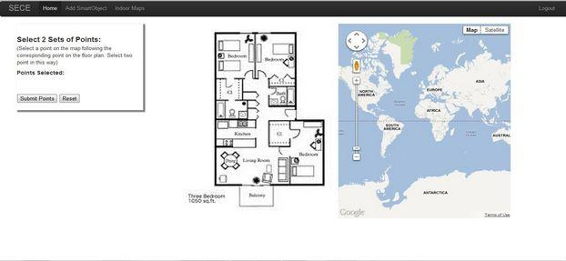
Indoor Maps
User must upload the floor-plan(s).
calibrate the floor-plans to convert subsequent points chosen on the floor-plan to latitude, longitude values.
User can add and delete indoor smartObjects

Slide 6
Lat, Lng Calculations
// d is the euclidean distance between the 2 points and pixToDist is the number which indicates conversion ratio from pixel distance to actual distance based on the 2 reference points provided by the user.
d = Math.sqrt((x1-x3)*(x1-x3) + (y1-y3)*(y1-y3)) * pixToDist/1000
//dx, dy are x and y coordinate distances to be coverted to actual distnace. IndvHeading is the heading of the point from the north pole.
dx = d*Math.sin(indvHeading)
dy = d*Math.cos(indvHeading)
// the constants 110540 and 111320 is to factor in the earth's oblateness
lat3 = lat1 + dy/110540;
lng3 = lng1 + dx/(111320*Math.cos(lat1));

Slide 7
Demo
http://localhost/new/SECE/index.php

Slide 8
Conclusion
Based on the current implementation I hope to provide a user with a new UI for the SECE system but also means for the system to accommodate new kinds of queries to be put in using the location information available to the system through the geoloc feature.
Future Works:
The most important one being the ability to add multiple floor plans for a single user thereby making it possible for this feature to be accessible for the user in a number of locations.
Get state information from smartObjects and display it in the system

Slide 9
Q & A
Thank you!

Slide 10
References
[1] http://maps.google.com/
[2]http://maps.google.com/intl/en/help/maps/streetview/#utm_campaign=en&utm_medium=van&utm_source=en-van-na-us-gns-svn [3] https://developers.google.com/maps/documentation/javascript/overlays#Markers
[4] https://developers.google.com/maps/documentation/javascript/geocoding
[5] https://developers.google.com/maps/documentation/javascript/streetview#StreetViewPov
[6] https://developers.google.com/maps/documentation/javascript/reference
[7] Twitter Bootstrap: http://twitter.github.com/bootstrap/
[8] Google maps API, geometry library: https://developers.google.com/maps/documentation/javascript/geometry
[9] Heading, Longitude & Latitude Calculations and definitions: http://www.movable-type.co.uk/scripts/latlong.html
[10] Google maps Overlay Tiler: http://code.google.com/p/overlay-tiler/
[11] Google maps tiler: http://code.google.com/p/maptiler/
[12] http://www.stackoverflow.com

